Slide 1
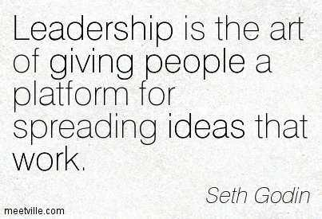
Journal Club – July 2018
Bob Marshall, MD MPH MISM FAAFP
Program Director, DoD/MAMC Clinical Informatics Fellowship

Slide 2
Article to Review
Military Research Needs in Biomedical Informatics
Jaques Reifan, PHD, Gary R. Gilbert, PHD, Lawrence Fagan, MD, PHD, Richard Satava, MD
Journal of the American Medical Informatics Association Volume 9 Number 5 Sep / Oct 2002

Slide 3
Introduction
This review paper identifies research priorities that can form the basis for making new strategic research investments in biomedical informatics by the military in general and by the USAMRMC in particular
Areas of focus:
Hospital and Clinical Informatics
E-Health
Combat Health Informatics
Bioinformatics and Biomedical Computation

Slide 4
Timeline and Prioritization
Within the four focus areas, several important areas of research needs were identified and assigned three timelines:
near-term (<2 years),
Midterm (2–5 years), and
long-term (>5 years)
The areas were then ranked into top-, high- and medium-priority

Slide 5
Biomedical Informatics Research Needs
military needs and requirements in biomedical informatics are different than in civilian settings
The MHS supports a continuum of care:
starts at the point of injury in the battlefield (Role I) with significant constraints
resources are scarce
The “working” environment is dynamic and unknown in advance
Goes all the way to Continental United States (CONUS)-based military and civilian hospitals (Role V),
results in requirements and system functionalities well beyond those in the civilian environment

Slide 6
Hospital and Clinical Informatics Working group
Examined opportunities to enhance the design, facilitate the use, and expedite the deployment of computer systems to optimize inpatient and ambulatory medical care
the group also addressed technologies that could potentially improve the access to clinical data and medical knowledge by both patients and providers

Slide 7
H&CIWG Focus Areas
Improved speed and completeness of data capture
Improved integration of data sources and computing services
Improved coverage and utility of decision-support systems
Improved access by patients and providers to medical data (patient records) and knowledge (medical literature)
Facilitation of interaction between patients, providers, and information resources to optimize patient care outcomes

Slide 8
H&CIWG Identified Barriers 1 of 2
Data capture techniques are too slow, awkward, or error-prone
Need improved data integration technologies
Need improved medical terminology mapping
Data capture are not always integrated into atient care process
Better tools and methods are needed to expedite the guideline-encoding process and integrate encoded guidelines within institutional environments
Decision-support systems are not easily adjustable for different medical contexts

Slide 9
H&CIWG Identified Barriers 2 of 2
Information retrieval systems do not support the precise retrieval of answers to biomedical questions13
For patient data to be useful, it often needs to be summarized and put in the appropriate context
Need improved mechanisms for sharing information between patients and providers
Need to model and understand the medical care process and provider needs in support of successful installation of computer-based tools

Slide 10
Question set #1
How close have we come to achieving/adequately addressing any of the five focus areas?
What technical barriers still exist?
What other major barriers exist in this area?
What research or activities do we need to overcome those barriers?

Slide 11
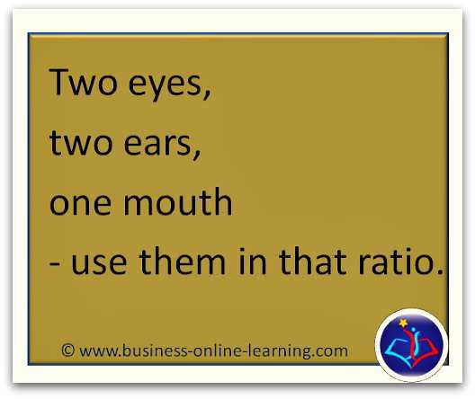

Slide 12
E-Health Working Group
challenges stem from the vast amount of available information whose quality has not been assessed
the rapid adoption of Internet-enabled and other information technologies provides significant opportunities to:
improve the quality of care delivered,
Drive economic efficiencies and reduce costs,
facilitate the linkage of fragmented systems, and
give consumers better access to information

Slide 13
Goals of the E-Health WG
Development and adoption of standards
Improved man-machine (device) interfaces
Identification of technology gaps to bridge various health services support systems
Improved interface among various applications and databases
Improved information access by patients and providers to enhance decision-making
Improved education of patients and providers about existing information technologies

Slide 14
E-Health WG Identified Barriers
Need to interface and/or integrate new applications with legacy systems
Lack of standards for a core set of quality care measures
Need to migrate from proprietary applications to standards-based, open source, generalizable, published applications and architectures to ensure interoperability
Need user-friendlier interfaces that provide customizable, quicker, and easier access to desired information
Lack of uniform evaluation criteria and automated methods to assess the quality of the ever increasing amount of online health care information

Slide 15
E-Health Research and Informatics Needs
Research needed to overcome the identified technical barriers falls into two categories: infrastructure and applications
Infrastructure research needs:
provide enabling technologies to overcome issues with interoperability, reliability, and technology gaps
provide the foundation for the next-generation of E-Health systems
Applications research needs:
support the development and deployment of new systems to reduce errors, and improve the effectiveness, timeliness, and efficiency of health care delivered
and that will relieve patients and providers from the painstaking tasks of fusing, sorting, searching, and extracting information from exponentially increasing health-related data sources

Slide 16
Question set #2
How close have we come to achieving/adequately addressing any of E-Health focus areas?
What technical barriers still exist?
What are the other major barriers to success in this area?
What research or activities do we need to overcome those barriers?

Slide 17
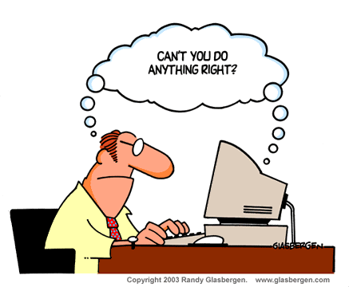

Slide 18
Combat Health Informatics Working Group
Working Group Focus:
On technologies that address environmental stressors - a leading cause of non-battle illness
On battlefield trauma - as the overwhelming majority of American combat deaths since World War II have occurred on the battlefield

Slide 19
CHI-WG Identified Areas
Entire process, starting at the collection of physiologic data at the sensors,
To the transmission of information to the medic and hospitals behind the front line of the battlefield (Role 1 to Role 3),
Creation of a central data repository system, and
Development of mathematical models for decision support

Slide 20
CHI-WG Goals – Overall View
for the five years after the conference and beyond:
improve the quality of medical care of the soldier in the battlefield through the use of information and computer-based tools

Slide 21
CHI-WG Specific Goals
Reduce the size and improve the reliability of physiologic sensor data and biosensor networks to effectively manage vast amounts of information in a timely fashion
Identify life-saving medical interventions and key physiologic parameters predictive of clinical outcome of trauma casualties
Construct trauma databases for knowledge extraction
Develop decision-support systems to aid combat medics in emergency triage, including patient monitoring, diagnostics, treatment, and prognostics
Develop computational tools to expedite and improve clinical training for medics, nurses, and doctors

Slide 22
Technology Barriers to CHI-WG Goals
Lack of sensor information redundancy (leads to missing or corrupted data)
Not understanding which of the informative physiologic data are needed to develop decision-support systems and more effective training tools
Need for database architecture that accommodates disparate data types from diverse sources
Divergent information needs and difficulty of moving data through various echelons or from one civilian hospital to another
Inadequate hardware and software compatibility for logistics and communications at all levels
Need universal yet secure communication systems

Slide 23
CHI-WG Research Needs
Four fundamental technology areas:
Sensing devices,
Communications and control (such as a central “command center” to coordinate disaster/trauma response),
Data warehousing, and
Modeling and simulation (to predict ongoing consequences of disaster/trauma response)

Slide 24
Question set #3
How close have we come to achieving/adequately addressing any of Combat Health Informatics focus areas?
What technical barriers still exist?
What are the other major barriers to success in this area?
What research or activities do we need to overcome those barriers?

Slide 25
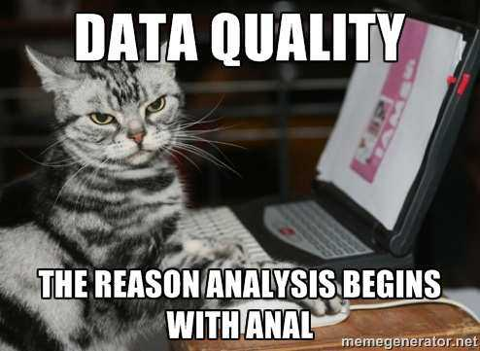

Slide 26
Bioinformatics and Biomedical Computation Working group
The goal is to speed the progress of bioscience and biomedical research through the power of computing to manage and analyze data that will support rapid scientific progress

Slide 27
BI&BC-WG Specific Goals
Fostering interdisciplinary research involving the collaboration of bioscentists and computer scientists
Creating better algorithms and tools to analyze genomic and proteomic data
Investigating the use of distributed databases consisting of heterogeneous types of data to identify, prepare for, and respond to emerging biological threats or diseases
Identifying specific applications of high-performing computing and communications (HPCC) that would enhance Army medical research
Encouraging the development of applications that would benefit from the large bandwidth of the Next-Generation Internet

Slide 28
BI&BC Technology Barriers 1 of 2
Some barriers relate to the lack of basic understanding of how genes - and the proteins they instruct the body to make - work
Other barriers relate to the lack of standards and methods associated with data acquisition, representation, archival, and retrieval
Noted technology barriers include:
Lack of standards for data characterization and storage in databases
Need to store massive amounts of data, which are being generated at exponentially increasing rates
Lack of flexible methods for indexing information and for purging/adding obsolete/new information

Slide 29
BI&BC Technology Barriers 2 of 2
Need for new data acquisition, registration and storage methods to accommodate disparate data types from diverse sources collected at different times
Inadequate data mining tools and algorithms for information visualization, knowledge extraction, and intelligent ad-hoc query in an ever-increasing data-rich environment
Inadequate security systems to protect networked computers and linked databases
Need to understand how genes and protein work and identify functional markers
Need for multiple data representation schemes to accommodate different user needs

Slide 30
BI&BC Research Needs
Research that is needed to overcome technical barriers falls into two broad areas: data management and data analysis
Research in data management addresses the four logical sequential elements (data acquisition, data representation, data archival, and data retrieval) of data processing from the point data are acquired to the point they can be retrieved for mining and analysis
Research needs in data analysis consist of modeling and simulation, knowledge extraction, and visualization algorithms

Slide 32
Question set #4
How close have we come to achieving/adequately addressing any of BI & BC WG focus areas?
What technical barriers still exist?
What are the other major barriers to success in this area?
What research or activities do we need to overcome those barriers?

Slide 33
Summary
Four major areas identified by this group in 2002 for Biomedical Research
Goals and barriers to achieving those goals outlined
It has now been 16 years since this group convened
What have we accomplished, and what have we learned in the interim?
Where do we go from here to identify new goals for Informatics Research, and how can we accomplish those goals within our given resource and Cybersecurity constraints?

Slide 34
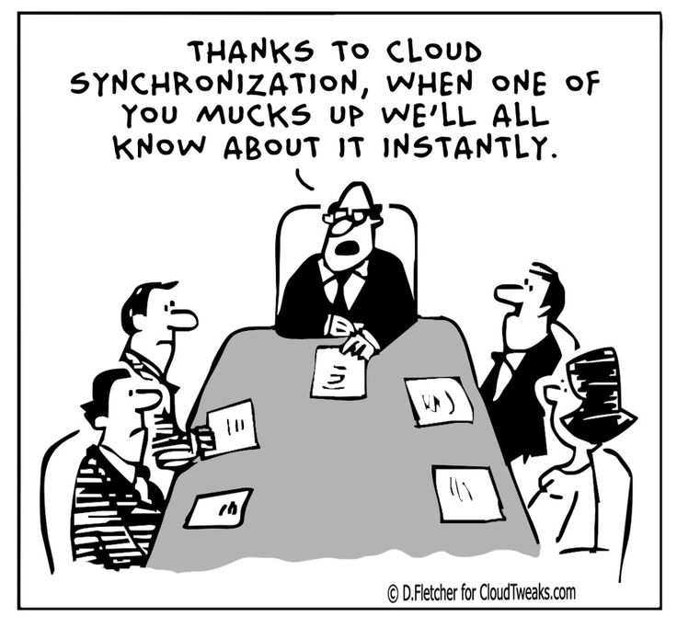
Additional Discussion

